Slide 1
CTS Reasoning
Vignesh m

Slide 2
Directions for Q1 to Q8: From the given choices select the odd one out.
1. (a) NR
(b) DW
(c) FU
(d) CX

Slide 3
Directions for Q1 to Q8: From the given choices select the odd one out.
2. (a) AA
(b) BB
(c) DDDD
(d) EEEEE

Slide 4
Directions for Q1 to Q8: From the given choices select the odd one out.
3. (a) Q3N
(b) P3N
(c) Q4M
(d) T2R

Slide 5
Directions for Q1 to Q8: From the given choices select the odd one out.
4. (a) SV2
(b) GI2
(c) BD2
(d) NR4

Slide 6
Directions for Q1 to Q8: From the given choices select the odd one out.
5. (a) MNPO
(b) PSRQ
(c) SVUT
(d) KNML

Slide 7
Directions for Q1 to Q8: From the given choices select the odd one out.
6. (a) KLNM
(b) HIKJ
(c) STVU
(d) RSTU

Slide 8
Directions for Q1 to Q8: From the given choices select the odd one out.
7. (a) RKOC
(b) ADNS
(c) LNDA
(d) RRIVE

Slide 9
Directions for Q1 to Q8: From the given choices select the odd one out.
8. (a) GJNS
(b) GHJM
(c) GIKM
(d) GILP

Slide 10
Directions for Q9 to Q11: Find the next number in the series.
9. 7, 8, 15, 23, 38, ………
(a) 57
(b) 61
(c) 62
(d) 54

Slide 11
Directions for Q9 to Q11: Find the next number in the series.
10. 79, 64, 26, 15, ………
(a) 9
(b) 6
(c) 10
(d) 8

Slide 12
Directions for Q9 to Q11: Find the next number in the series.
11. 3, 6, 18, 108, ………
(a) 1250
(b) 1080
(c) 1944
(d) 1688

Slide 13
Directions for Q12 to Q15: Decode the word(s)/pattern given in the question.
12. If NORMAL is coded as LAMRON, then SYSTEM is coded as:
(a) METSYS
(b) TXTUDN
(c) TZTUFN
(d) METSSY

Slide 14
Directions for Q12 to Q15: Decode the word(s)/pattern given in the question.
13. If STICK is coded as RSHBJ, then REPLY is coded as:
(a) SFQNX
(b) SFQMZ
(c) QDOMX
(d) QDOKX

Slide 15
Directions for Q12 to Q15: Decode the word(s)/pattern given in the question.
14. If BLACK is coded as DNCEM, then ORANGE is coded as:
(a) QTCOIG
(b) PSCOHF
(c) QTCPIG
(d) PSBOHF

Slide 16
Directions for Q12 to Q15: Decode the word(s)/pattern given in the question.
15. If UFYBW represents RIVET, what does TRDOWBU stand for?
(a) TARTAR
(b) QUTAR
(c) TUARTER
(d) QUARTER

Slide 17
Directions for Q16 to Q19: Choose the correct option.
16. QDXM : SFYN :: UIOZ : ?
(a) LPWA
(b) PAQM
(c) QNLA
(d) WKPA

Slide 18
Directions for Q16 to Q19: Choose the correct option.
17. QPS : TSV :: IHK : ?
(a) LKN
(b) MKN
(c) LOM
(d) NQP

Slide 19
Directions for Q16 to Q19: Choose the correct option.
18. 6 : 60 :: 210 : ?
(a) 240
(b) 120
(c) 504
(d) 280

Slide 20
Directions for Q16 to Q19: Choose the correct option.
19. 215 : 35 :: 511 : ?
(a) 29
(b) 63
(c) 71
(d) 60

Slide 21
20. Radha is the only daughter of Rakesh’s father-in-law’s wife. How is Radha related to Rakesh?
(a) Sister
(b) Daughter
(c) Cousin
(d) Wife

Slide 22
21. Saurabh had to go to his brother’s paternal uncle’s sister’s husband’s father-in-law’s only granddaughter’s house. Whose house did Saurabh have to go to?
(a) Sister
(b) Brother
(c) Daughter
d) Sister or cousin

Slide 23
When I met Mr. Harish at a wedding, he pointed out to a person and said, “Kiran is your mother’s only sister’s son’s wife”. How is Kiran related to me?
(a) Sister (b) Cousin in law (c) Niece
(d) Aunt (e) Data insufficient

Slide 24
23. If Mohan is the Husband of Rohan’s grandmother, how is Rohan related to Mohan?
(a) Brother-in-law
(b) Grandson
(c) Grandfather
(d) Uncle

Slide 25
24. Introducing a woman, a man said, “Her husband is the only son of my father.” How is the woman related to the man?
(a) Mother-in-law
(b) Sister
(c) Daughter
(d) Wife

Slide 26
Choose the correct option.
25. Introducing a woman, a man said, “Her husband is the only son of my father.” How is the woman related to the man?
(a) Mother-in-law (b) Sister (c) Daughter (d) Wife

Slide 27
26. Mannat drives his truck from point 1 and takes it 20 km North, from where he turns right and drives 30 km. Then he turns right again and drives for another 20 km and reaches point 2. In what direction did he drive once he took the second turn?
(a) South
(b) North
(c) East
(d) West

Slide 28
27. A boy is facing North . He turns 90º in the anticlockwise direction and then 135º in Clockwise direction. Which direction is he facing now?
(a) South-West
(b) South
(c) North- East
(d) South-East

Slide 29
28. Two friends Raman and Rajan start a race and run together for 20 kms towards east. From there, Raman runs 10 kms towards north-east and Rajan continues running in the east for 8 kms. How far are the two friends now from each other?
(a) 30 kms
(b) 20 kms
(c) 6 kms
(d) 18 kms

Slide 30
29. Meeru has lost her way home and was standing 25 meters away from her house in the south-west direction. She walks 20 meters north and reaches point A. How far and in which direction would she have to walk to reach her house?
(a) 15 meters, West
(b) 20 meters, East
(c) 20 meters, West
(d) 15 meters, East

Slide 31
30. X walks 6 km towards east from a point A and from the same point A, Y walks 8 km towards south. How far are the two friends from each other now?
(a) 14 km
(b) 5 km
(c) 2 km
(d) 10 km

Slide 32
Directions for Q31 to Q35: Choose the option that arranges the given set of words in the ‘most’ meaningful order. The words when put in order should make logical sense according to size, quality, quantity, occurrence of events, value, appearance, nature, process, etc.
31. 1. Jupiter 2. Mars 3. Neptune
4. Mercury 5. Venus
(a) 4, 2, 5, 1, 3 (b) 2, 5, 4, 1, 3
(c) 4, 5, 2, 1, 3 (d) 2, 4, 5, 1, 3

Slide 33
Directions for Q31 to Q35: Choose the option that arranges the given set of words in the ‘most’ meaningful order. The words when put in order should make logical sense according to size, quality, quantity, occurrence of events, value, appearance, nature, process, etc.
32. 1. Community 2. Locality 3. Family
4. Country 5. Person
(a) 4, 1, 2, 5,3 (b) 4, 2, 1, 3, 5
(c) 5, 3, 2, 1, 4 (d) 5, 3, 4, 2, 1

Slide 34
Directions for Q31 to Q35: Choose the option that arranges the given set of words in the ‘most’ meaningful order. The words when put in order should make logical sense according to size, quality, quantity, occurrence of events, value, appearance, nature, process, etc.
33. 1. Dress 2. Yarn 3. Cotton
4. Stitching 5. Plant
(a) 5, 3, 2, 4, 1 (b) 5, 3, 1, 4, 2
(c) 1, 2, 3, 4, 5 (d) 3, 5, 2, 1, 4

Slide 35
Directions for Q31 to Q35: Choose the option that arranges the given set of words in the ‘most’ meaningful order. The words when put in order should make logical sense according to size, quality, quantity, occurrence of events, value, appearance, nature, process, etc.
34. 1. Consultation 2. Disease 3. Recovery
4. Doctor 5. Medicine
(a) 2, 4, 5, 1, 3 (b) 2, 4, 1, 5, 3
(c) 2, 1, 5, 4, 3 (d) 2, 1, 4, 5, 3

Slide 36
Directions for Q31 to Q35: Choose the option that arranges the given set of words in the ‘most’ meaningful order. The words when put in order should make logical sense according to size, quality, quantity, occurrence of events, value, appearance, nature, process, etc.
35. 1. Office 2. Cabin 3. City
4. Desk 5. Building
(a) 2, 4, 5, 3, 1 (b) 2, 4, 1, 5, 3
(c) 4, 2, 1, 5, 3 (d) 4, 2, 5, 3, 1

Slide 37
36. The question consists of a problem question followed by two statements I and II. Find out if the information given in the statement(s) is sufficient in finding the solution to the problem.
P, Q, R, S are four friends. Who is the youngest among them?
Statements:
I. The total age of P and Q is more than that of R.
II. The total age of P and S together is less than that of R.
(a) Statement I alone is sufficient
(b) Statement II alone is sufficient
(c) Both statements put together are sufficient
(d) Both the statements even put together are not sufficient

Slide 38
37.The question consists of a problem question followed by two statements I and II. Find out if the information given in the statement(s) is sufficient in finding the solution to the problem.
How many sisters does Shalini have?
Statements:
I) Her father has three children.
II) Her brother has two sisters.
(a) Statement I alone is sufficient
(b) Statement II alone is sufficient
(c) Both statements put together are sufficient
(d) Both the statements even put together are sufficient

Slide 39
Directions for Q38 to Q40: There are 3 questions based on the same puzzle. Answer the questions based on the given information:
(i) X, Y, Z, P and R are sitting in a row in front of a camera.
(ii) X is on the left of the person sitting in the centre, but is on the right of Y.
(iii) Z is on the right of P and R is on the right of Z.
(iv) R is the second person from the person sitting in the centre.
38. Who is between X and Z?
(a) Y (b) P
(c) Data inadequate (d) None of the above

Slide 40
Directions for Q38 to Q40: There are 3 questions based on the same puzzle. Answer the questions based on the given information:
(i) X, Y, Z, P and R are sitting in a row in front of a camera.
(ii) X is on the left of the person sitting in the centre, but is on the right of Y.
(iii) Z is on the right of P and R is on the right of Z.
(iv) R is the second person from the person sitting in the centre.
39. Who is sitting in the centre?
(a) X (b) P (c) Y (d) Z

Slide 41
Directions for Q38 to Q40: There are 3 questions based on the same puzzle. Answer the questions based on the given information:
(i) X, Y, Z, P and R are sitting in a row in front of a camera.
(ii) X is on the left of the person sitting in the centre, but is on the right of Y.
(iii) Z is on the right of P and R is on the right of Z.
(iv) R is the second person from the person sitting in the centre.
40. Who is sitting in the corner?
(a) P (b) X (c) Y (d) Z

Slide 42
Directions for Q41 to Q44: There are 4 questions based on the same puzzle. Answer the questions based on the given information:
A, S, O, D, F, T are members of a family consisting of 3 men and 3 women, among whom there are two married couples. We also know that:
(i) O is the son of S.
(ii) T is the daughter of D.
(iii) F is the grandson of A.
(iv) D is the mother of a girl and a boy.
(v) S is not the father of O.
(vi) All the relationships mentioned above are between these six persons only.
41. D’s husband is
(a) O (b) F (c) A (d) None of these

Slide 43
Directions for Q41 to Q44: There are 4 questions based on the same puzzle. Answer the questions based on the given information:
A, S, O, D, F, T are members of a family consisting of 3 men and 3 women, among whom there are two married couples. We also know that:
(i) O is the son of S.
(ii) T is the daughter of D.
(iii) F is the grandson of A.
(iv) D is the mother of a girl and a boy.
(v) S is not the father of O.
(vi) All the relationships mentioned above are between these six persons only.
42. O’s father is
(a) F (b) S (c) A (d) D’s father

Slide 44
Directions for Q41 to Q44: There are 4 questions based on the same puzzle. Answer the questions based on the given information:
A, S, O, D, F, T are members of a family consisting of 3 men and 3 women, among whom there are two married couples. We also know that:
(i) O is the son of S.
(ii) T is the daughter of D.
(iii) F is the grandson of A.
(iv) D is the mother of a girl and a boy.
(v) S is not the father of O.
(vi) All the relationships mentioned above are between these six persons only.
43. A’s wife is
(a) D (b) T (c) S (d) None of these

Slide 45
Directions for Q41 to Q44: There are 4 questions based on the same puzzle. Answer the questions based on the given information:
A, S, O, D, F, T are members of a family consisting of 3 men and 3 women, among whom there are two married couples. We also know that:
(i) O is the son of S.
(ii) T is the daughter of D.
(iii) F is the grandson of A.
(iv) D is the mother of a girl and a boy.
(v) S is not the father of O.
(vi) All the relationships mentioned above are between these six persons only.
44. T’s grandmother is
(a) D (b) A (c) S (d) F’s mother

Slide 46
45. The question consists of a problem question followed by two statements I and II. Find out if the information given in the statements(s) is sufficient in finding the solution to the problem.
How many daughters does A have?
Statements:
I. A’s wife has four sons: P, Q, R and S.
II. S has one sister.
(a) Statement I alone is sufficient.
(b) Statement it alone is sufficient.
(c) Both statements put together are sufficient.
(d) Both the statements even put together are not sufficient.

Slide 47
46. The question consists of a problem question followed by two statements I and II. Find out if the information given in the statements(s) is sufficient in finding the solution to the problem.
Is Raju taller than Saroj?
Statements:
I. Rakesh is of the same height as Raju and Saroj.
II. Saroj is shorter than Rakesh.
(a) Statement I alone is sufficient.
(b) Statement II alone is sufficient
(c) Both statements put together are sufficient
(d) Both the statements even put together are not sufficient
(e) Either of the statements is sufficient.

Slide 48
What day is the fourteenth of a given month?
(I)The last day of the month is a Wednesday.
(II)The third Saturday of the month was seventeenth.
(a) if the data in statement I alone are sufficient to answer the question;
(b) if the data in statement II alone are sufficient to answer the question;
(c) if the data either in I or II alone are sufficient to answer the question;
(d) if the data even in both the statement together are not sufficient to answer the question;
(e) if the data in both the statements together are needee

Slide 49
Among four friends A, B, C and D, who is the heaviest?
(I) B is heavier than A, but lighter than D.
(II) C is lighter than B.
(a) if the data in statement I alone are sufficient to answer the question;
(b) if the data in statement II alone are sufficient answer the question;
(c) if the data either in I or II alone are sufficient to answer the question;
(d) if the data even in both the statements together are not sufficient to answer the
question;
(e) if the data in both the statements together are needed.

Slide 50
49. A decision has to be taken on the basis of the given conditions. There are two cases based on the same set of conditions. Take a decision for both the cases and mark the correct answer for each.
Following are the conditions imposed by an employer for providing Rs.3 lacs as Leave Travel Concession to the employees.
The employees:
1. Must have performed 2 journeys in a block of 4 calendar years (Current block: 2010-2013).
2. Must have made only 1 trip in 1 year.
3. Must have made one trip within India, while the other could have been outside India.
4. Should have made a trip with less than 5 people.
5. The total cost of both the trips should not have exceeded Rs.7 lacs.

Slide 51
However,
(a) if the employees fulfil all conditions except (4) then he/she would get R.2.5 Iacs as concession.
(b) if the employees fulfil all conditions except (5) then he/she would get Rs.2 lacs as concession.
How much concession would be given to the given employee? (The case is presented as on 1.12.2012)
Rajesh, along with his wife and 2 kids went for vacations within India. He made his first trip in January, 2010 and second in May, 2010. The total cost of both the trips was Rs.2.5 lacs.
(a) Employee would not be given any concession
(b) Employee would be given Rs.3 lacs concession
(c) Employee would be given Rs.2 lacs concession
(d) Employee would be given Rs.2.5 Iacs concession
(e) Data insufficient

Slide 52
50. A decision has to be taken on the basis of the given conditions. There are two cases based on the same set of conditions. Take a decision for both the cases and mark the correct answer for each.
The following are the criteria for giving 10% bonus to employees.
1. The employee should have worked in his/her current post for more than 6 months.
2. The employee should have been rated as atleast 7/10 by his/her reporting manager and 6/10 by his colleagues.
3. The employee should be a part of atleast one employee engagement activity conducted in the office.
4. The employee should have taken part in the employee personality development programme atleast once after joining the organization.
5. The employee should have (a) worked in the organization for a year and (b) should have had atleast 1 year of work experience prior to this job.

Slide 53
However,
(a) Employees who fullfil all conditions except (2) should be given 5% bonus.
(b) Employees who fullfil all conditions except (5b) should be given 7% bonus.
Should the given employee be given 10% bonus? (The case is presented as on 1.12.2012)
Saurabh is the incharge of the employee engagement progammes conducted in the office and has been an active participant in all the initiatives. He is at the post of Senior HR Manager ever since he joined the organization 1.5 years back. Previously he was working with Auction.com as the HR Manager and had a work experience of 1 year there. Owing to his zeal and exuberance, he was rated 8/10 by his reporting manager and 9/10 by his colleagues. He attended the personality development programme twice ever since he joined the organization.
(a) Employee should be given 10% bonus
(b) Employee should be given 7% bonus
(c) Employee should be given 5% bonus
(d) Employee should not be given any bonus
(e) Data sufficient

Slide 54
2,4,12,48
a)240
b) 960
c) 480
d) 340

Slide 55
KJA: JKH:: SMO:
A) QNK
B) QPL
C) PNL
D) PQK

Slide 56
A-B means A plus B
A #B means A is multiplied with B
A/B means A is greater than or equal to B
A?B means A is less than B
whch one is definitely true ?
Statements:
(V#X) / (V-X) , X?Y and Z/Y
Conclusion:
1) X?Z
2) (V-X) ? (V#X)
a) only 1 true
b) only 2 true
c)both are correct
d) none of these true

Slide 57
“!” denotes “greater than”
“*” denotes “ equal to”
“+” denotes “ less than “
“$” denotes “ not equal to
“x” denotes “ not less than”
“”%” denotes “ not greater than”
A!B!C does not imply
a) C+B+A
b) C+A! B
c) B+A/C
d) B+A+C

Slide 58
0,1,1,2,3,7,?
a) 52
b) 22
c) 27
d) 46

Slide 59
P +Q means P is greater than Q
P*Q means P is greater than or equal to Q
P=Q means P is equal to Q
P/Q means P is less than Q
P-Q means P is less than or equal to Q
Statement: X/R,R+Y,Y-X,Z+Y,Z*R
Conclusion: (1) (Y-X) + R
(2) Z+(X/R)
a) only 1 true
b) only 2 true
c) Both 1 and 2 are true
d) Both are false

Slide 60
A < B means A is greater than b
A@ B means A is less than B
A*B means A is 5 more than B
A?B means B is 2 more tha A
which of the following is/are definitely true ?
Statement : R*S,T?S and U<T
Conclusion:
1. R<T
2. R* U
a) only 1 true
b) only 2 true
c) both are correct
d) Both are false

Slide 61
R@S means R is less than or equal to S
R*S means R is greater than or equal to S
R&S means R is greater than S
R^S means R is less than S
Statements: Y^X, Y&Z, X*W,W@V
conclusion:
1) X & V
2) W ^ Y
a) only 1 true
b) only 2 true
c) both are correct
d) Both are false

Slide 62
A +B means “ A is the Father of B “
A-B means “ A is brother of B”
A*B means “ B is the son of A”
A/B means “ A is the husband of B “
which of the following indicates that “ X is the grandfather of Z” ?
a) X+Y*R-S/Z
B) X+Y-R/S*Z
C) X+Y/R*S*Z
D) X+Y-R*S/Z

Slide 63
A+B means A is greater than B
A-B means A is less than B
A= B means A is greater than equal to B
A*B means A is equal to B
A/B means A is not equal to B
Statements: M-N,N*O,O-P
Conclusion: 1. M-O
2. N-P
a) only 1 true
b) only 2 true
c) both are correct
d) Both are false

Slide 64
There are 4 questions based on the same puzzle. Answer the questions based on the given
Information:
(1) Six friends P. Q. R. S. T and U are members of a club and play a different game of Football. Cricket.
Tennis, Basketball, Badminton and Volleyball.
(II) T who is taller than P and S plays Tennis.
(Ill) The tallest among them plays Basketball.
(IV) The shortest among them plays Volleyball
(v) Q and S neither play Volleyball nor Basketball.
(vi) R plays Volleyball.
(vil) T is between Q who plays Football and P In order of height.
Who is taller than R but shorter than P?
a) Q b) T c) U d) data sufficiency e) None of these

Slide 65
The given signs signify something and on that basis, assume the given statements to be true
and find which of the two conclusions | and II is/are definitely true.
P + Q means P is greater than Q.
p * Q means P is greater than but not equal to Q.
P = Q means P is equal to Q.
P / Q means P is less than or equal.
P - Q means P is less than Q.
Statements:
R + (S/ U). U+(T-(S=Z)).Z+(R* U)
Conclusions:
(1) S + (R * T )
(11) R/ ( T -S)

Slide 66
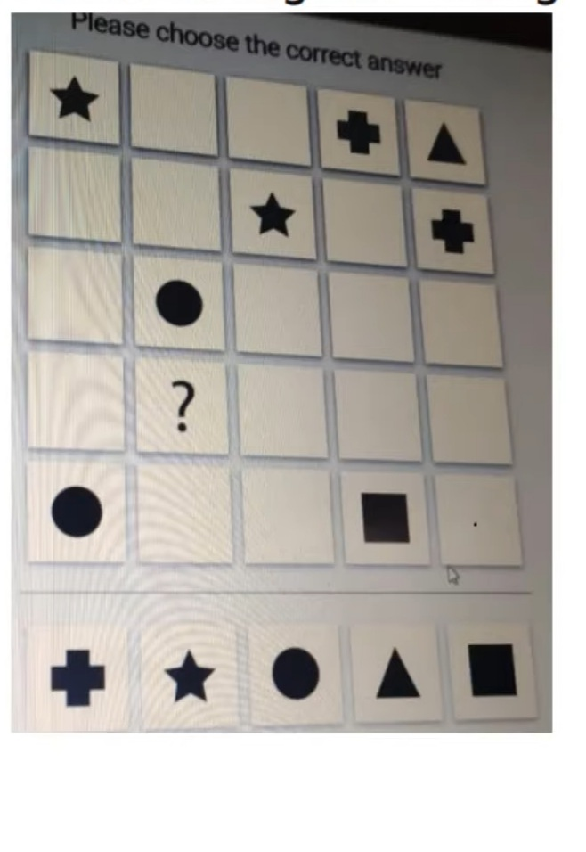
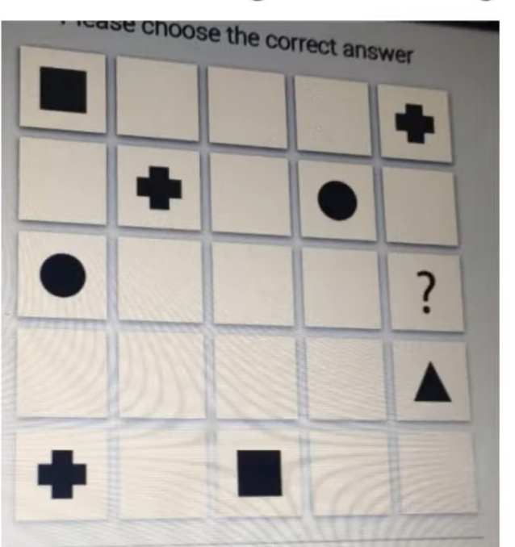

Slide 67
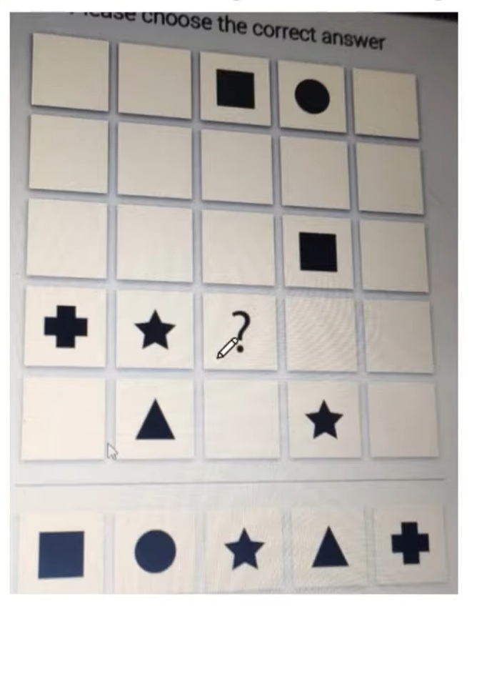

Slide 68
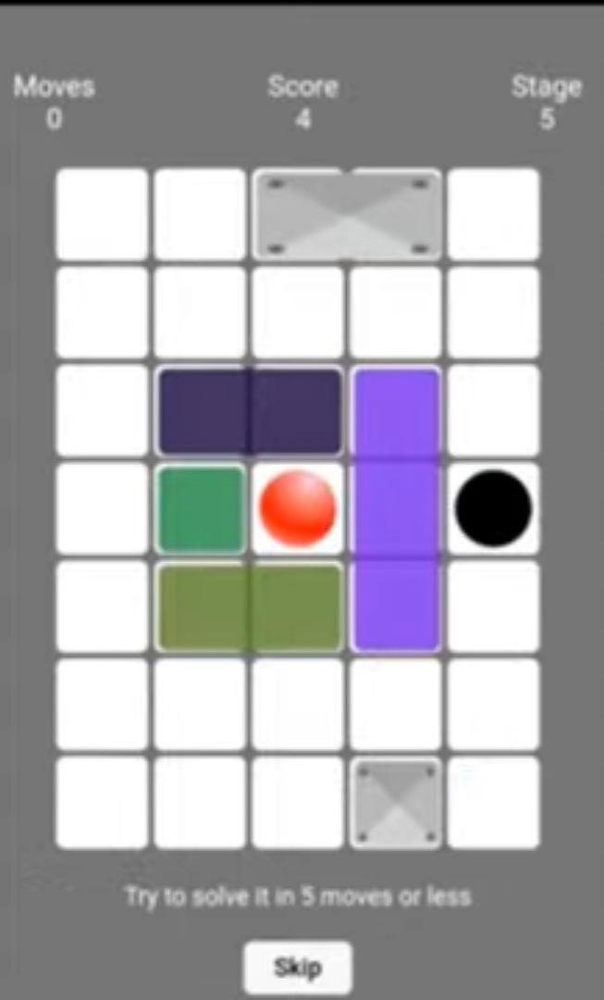
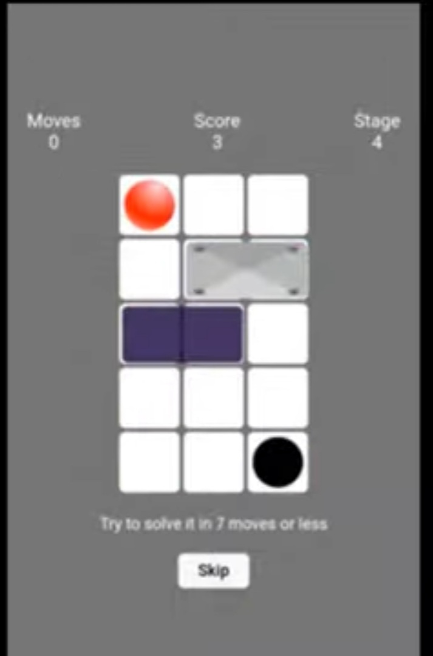

Slide 69
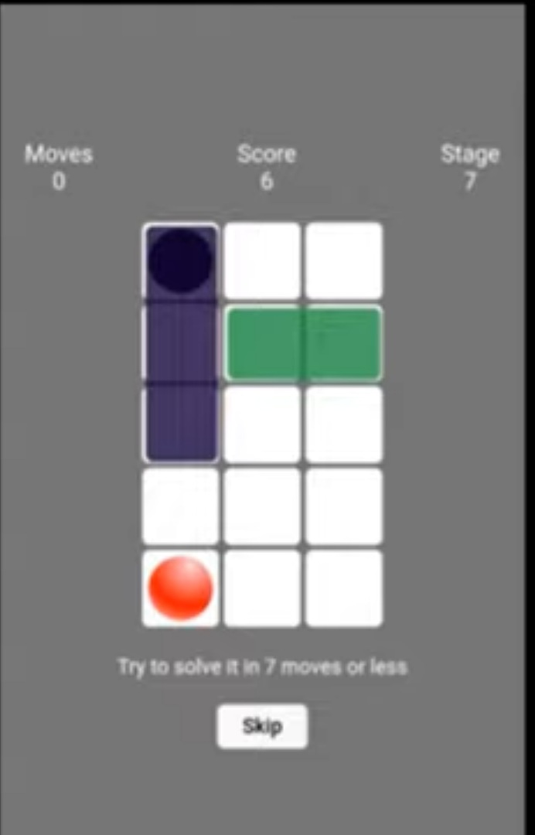
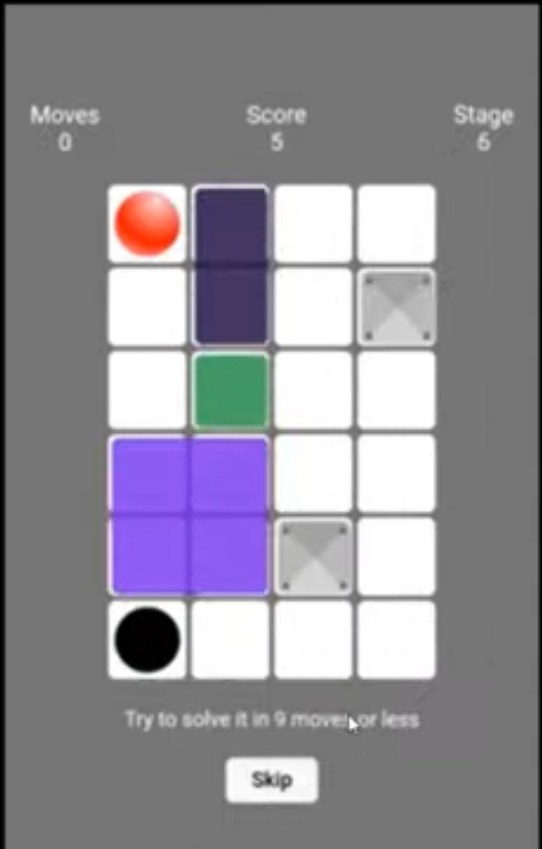

Slide 70
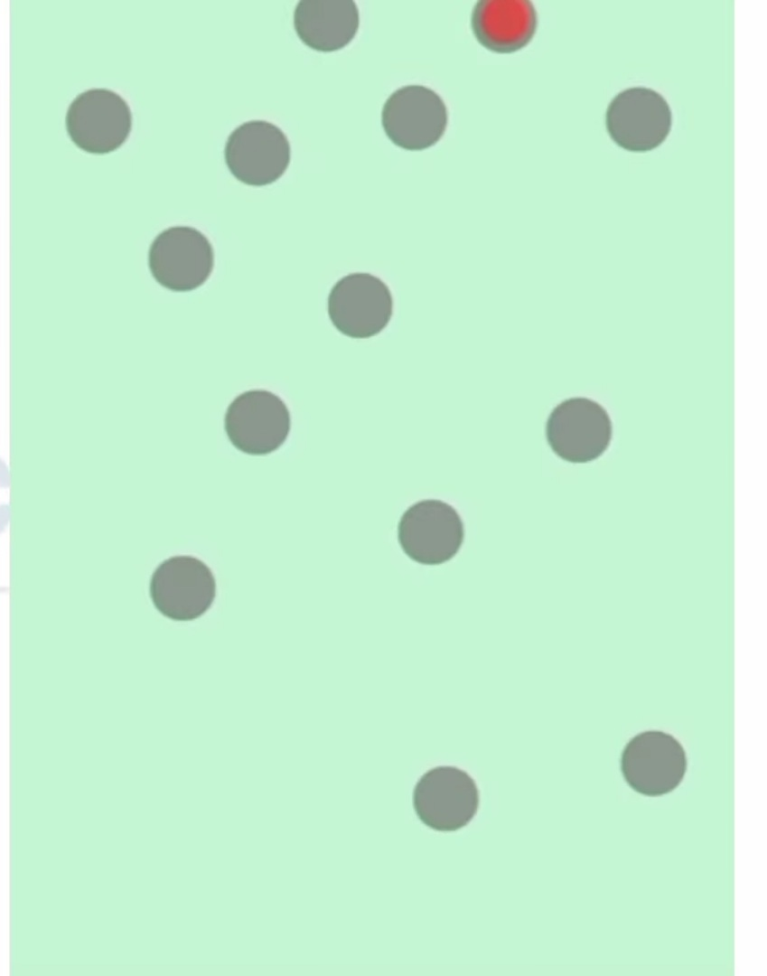

Slide 71
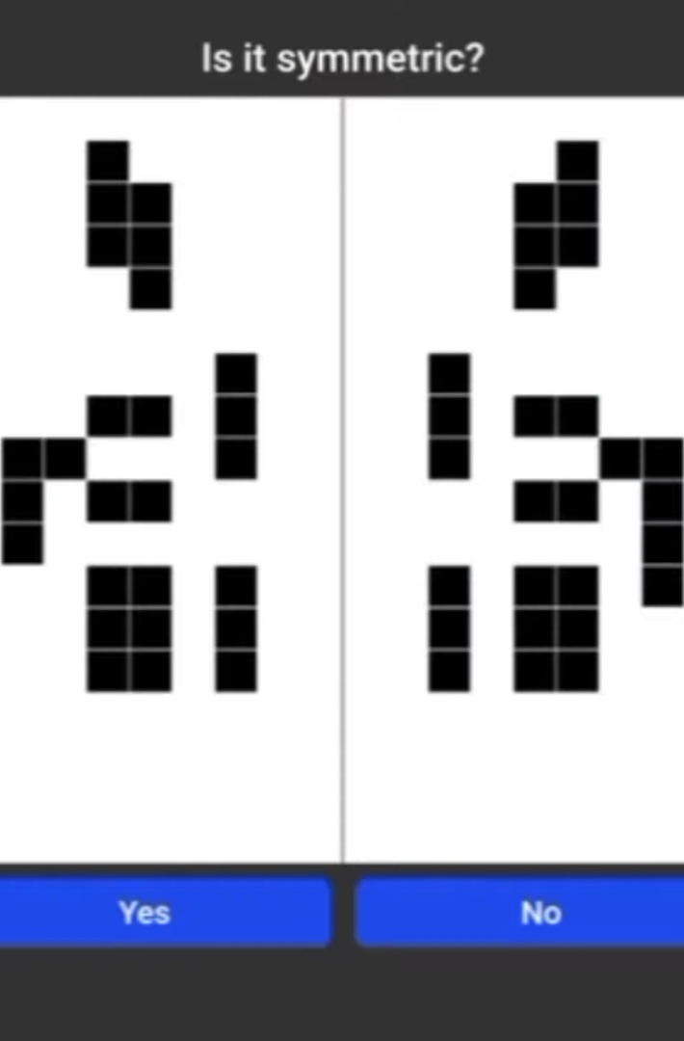

Slide 72


Slide 73
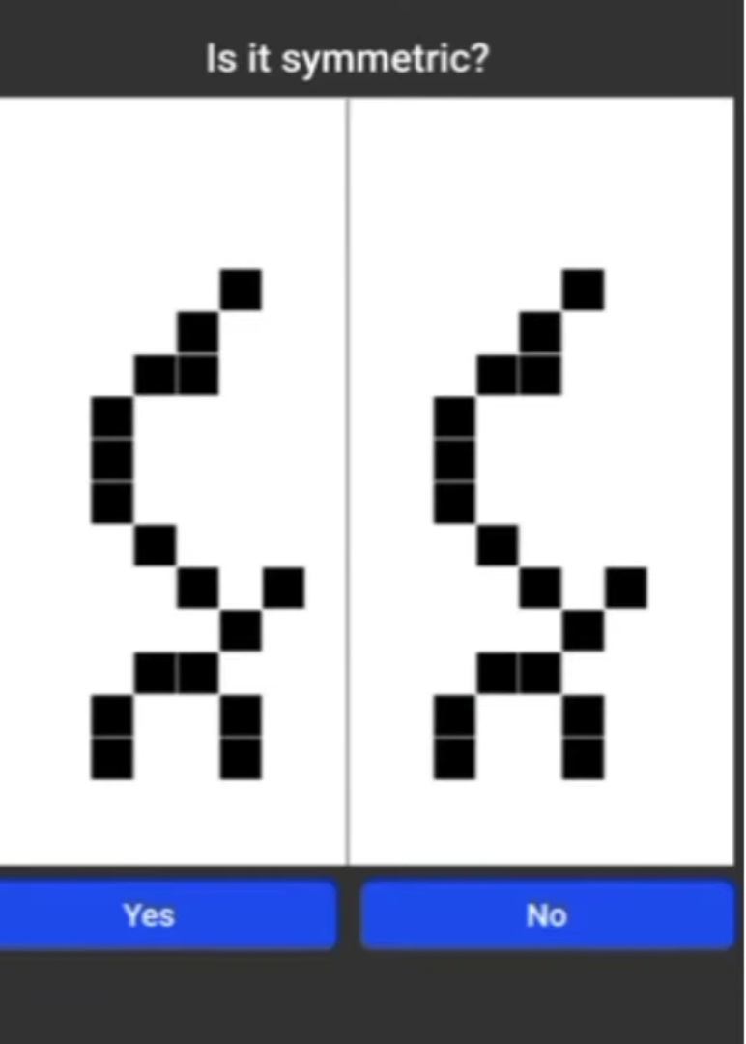

Slide 74
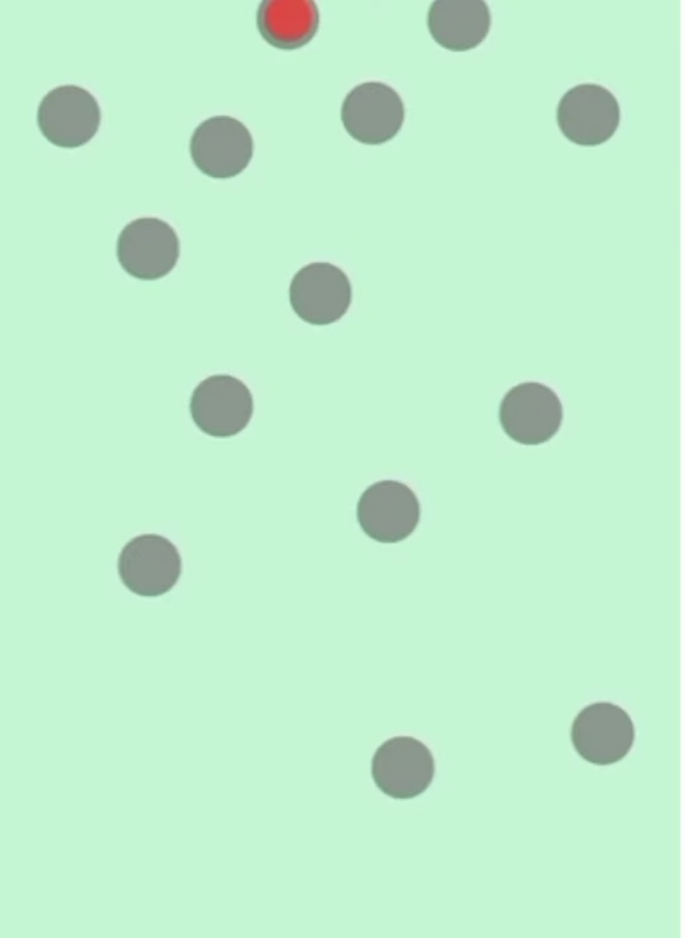

Slide 75
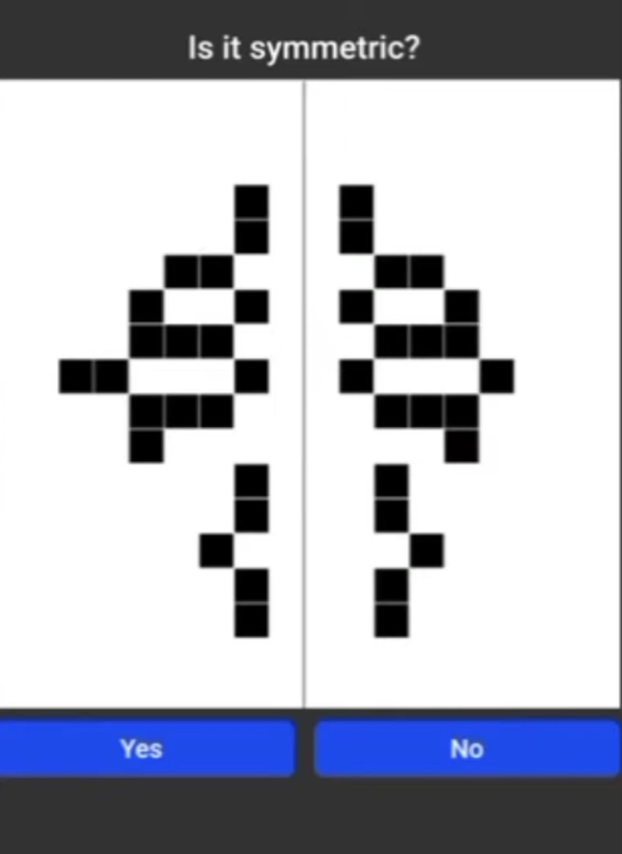

Slide 76


Slide 77
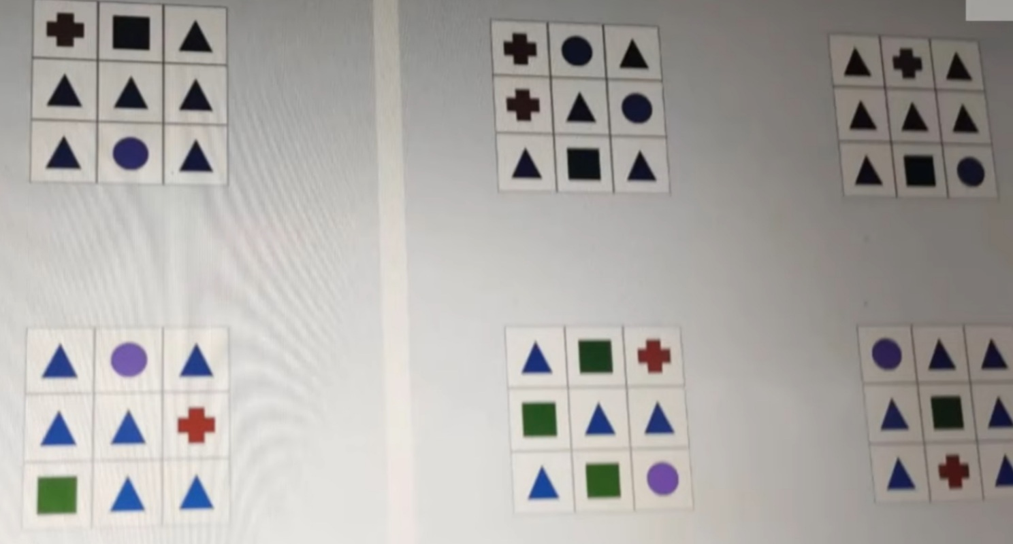
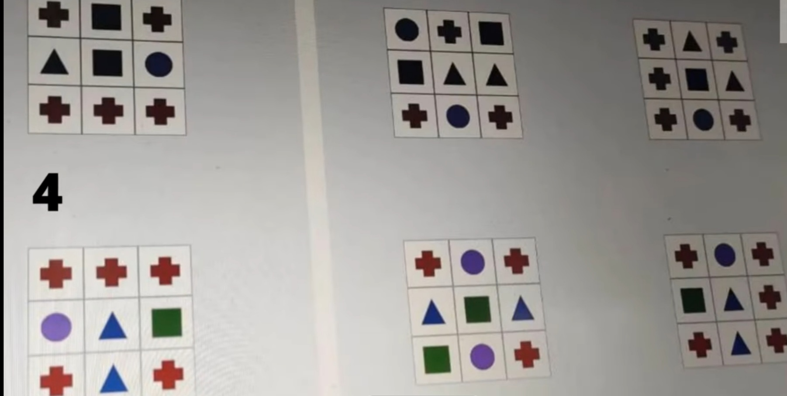

Slide 78
THANK YOU

